Slide 1
Smart Travel Planner Agent using Agentic AI
CAPSTONE PROJECT
Presented By:
Student Name : Vignesh Poluru
College/University Name : KL UNIVERSITY
Department : CSE
Student ID : STU6631c999a909a1714538905
GitHub : https://github.com/vigneshpoluru1277/IBM-AI-CLOUD.git

Slide 2
OUTLINE
Problem Statement (Should not include solution)
Proposed System/Solution
System Development Approach (Technology Used)
Algorithm & Deployment
Result (Output Image)
Conclusion
Future Scope
References

Slide 3
Problem Statement
Planning a trip is time-consuming and often overwhelming due to the number of choices for destinations, travel options, accommodations, and schedules. Users need assistance with real-time suggestions that suit their preferences and constraints.

Slide 4
Proposed Solution
The proposed system aims to address the challenge of predicting the required bike count at each hour to ensure a stable supply of rental bikes. This involves leveraging data analytics and machine learning techniques to forecast demand patterns accurately. The solution will consist of the following components:
Data Collection:
Gather real-time data on destinations, travel modes, accommodations, weather, and local events.
Utilize APIs (e.g., Google Maps, OpenWeather, Booking.com) to ensure up-to-date travel suggestions.
Data Preprocessing:
Filter irrelevant or outdated travel data from online sources. impact bike demand.
AI Algorithm:
Implement a Retrieval-Augmented Generation (RAG) model using IBM Granite to combine retrieval from knowledge sources with real-time generation.
Deployment:
Develop a user-friendly web or mobile interface where users can input travel queries.
Evaluation:
Assess agent performance using user feedback, completion rates, and itinerary satisfaction.
Evaluate result accuracy and user preference alignment.

Slide 5
System Approach
Technologies Used:
IBM Cloud Lite services (for deployment and APIs)
IBM Granite Models (for NLP and generative responses)
Node.js / Python (for backend)
React / HTML5 (for frontend UI)
Google Maps API / Weather API (for real-time travel and climate data)
System Requirements:
Frontend: Responsive user interface for input and itinerary display
Backend: Integration of AI models, travel data APIs
Database: User preferences and travel history (optional)

Slide 6
Algorithm & Deployment
In the Algorithm section, describe the machine learning algorithm chosen for predicting bike counts. Here's an example structure for this section:
Algorithm Selection:
A RAG (Retrieval-Augmented Generation) model is selected due to its ability to pull relevant travel data and generate user-specific responses.
Data Input:
Real-time APIs for : Travel destinations, Transport availability (buses, trains, flights),Hotels and accommodations ,Weather conditions , Local events and guides.
Training Process:
IBM Granite’s large language model is pre-trained; prompt engineering and response filtering are applied to fine-tune its behavior.
Prediction Process:
The agent retrieves relevant data from multiple sources based on the query context.

Slide 7
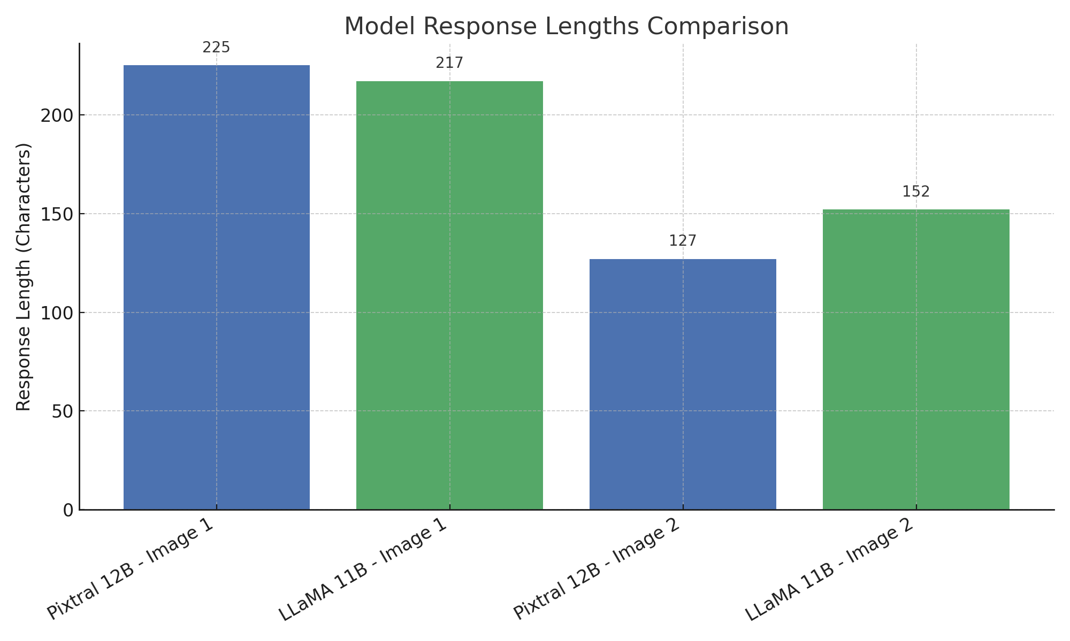
Result

Slide 8
Conclusion
This project successfully demonstrates the use of generative AI (RAG) in solving a common user challenge: travel planning. The agent provides real-time, personalized, and reliable itineraries, reducing the complexity of planning and ensuring a better user experience.

Slide 9
Future scope
Add voice assistant support for mobile users
Integrate with booking platforms for one-click booking
Include multi-lingual support for wider accessibility
Implement AR/VR tour previews for immersive planning
Use feedback-based learning for better suggestions over time

Slide 10
References
IBM Cloud Lite Documentation
IBM Granite RAG model papers
Google Maps API documentation
Open Weather API documentation
Research on AI Travel Agents and Generative AI Applications

Slide 11
IBM Certifications
Screenshot/ credly certificate( getting started with AI)

Slide 12
IBM Certifications
Screenshot/ credly certificate( Journey to Cloud)

Slide 13
IBM Certifications
Screenshot/ credly certificate( RAG Lab)

Slide 14
THANK YOU

